Slide 1
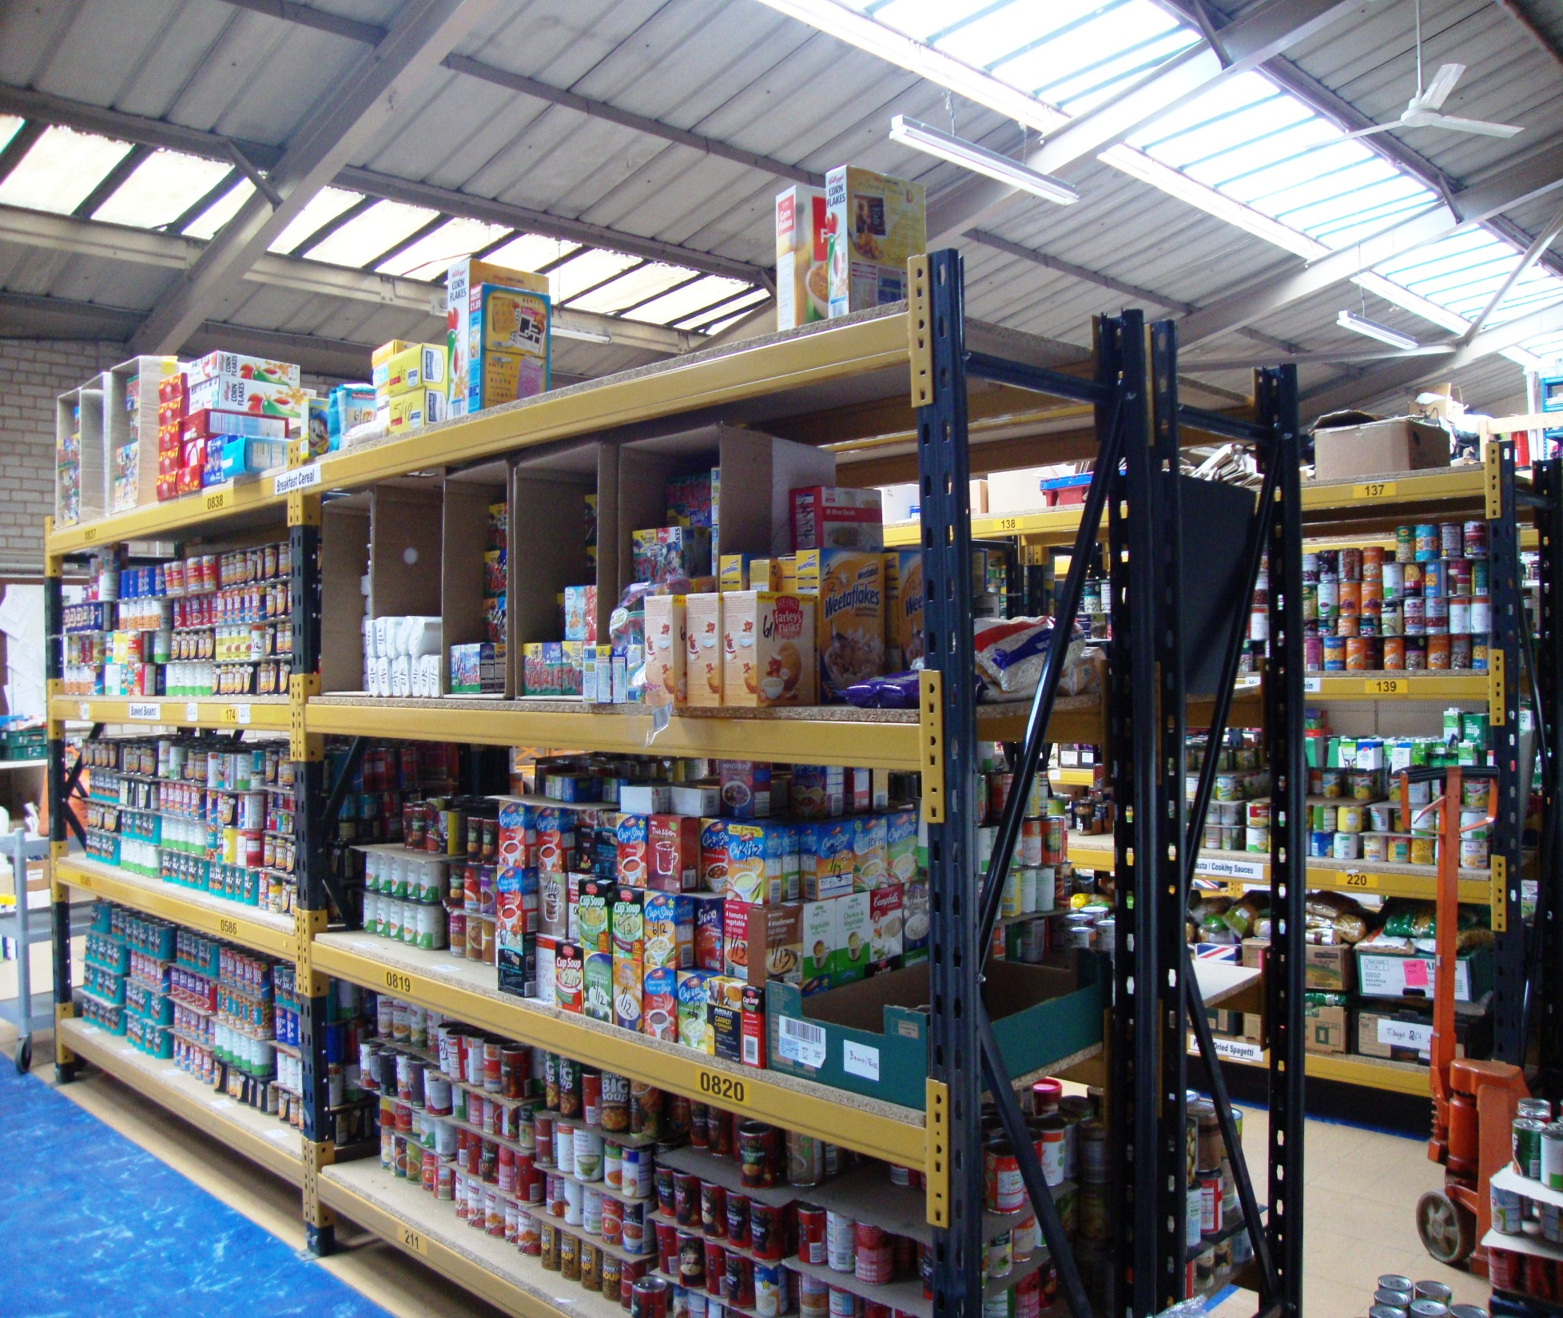



Slide 2
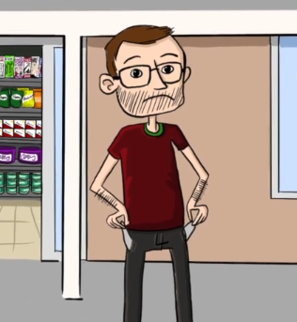
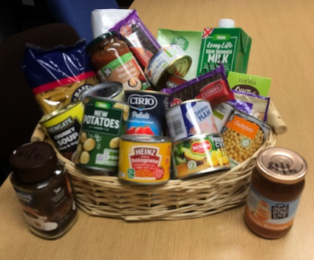
What does a Foodbank do?
We give people in crisis…..
…enough food to last for 3 days
To help them feel a bit better…
…and get help to sort out their problems

Slide 3
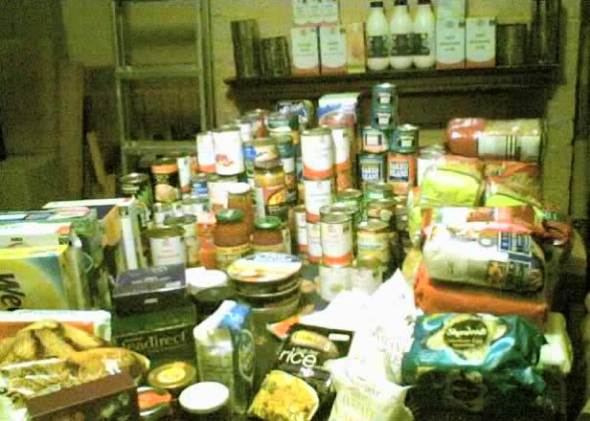
Black Country Foodbank
Started by Wendy in 2006
Wendy fed 45 people that year

Slide 4
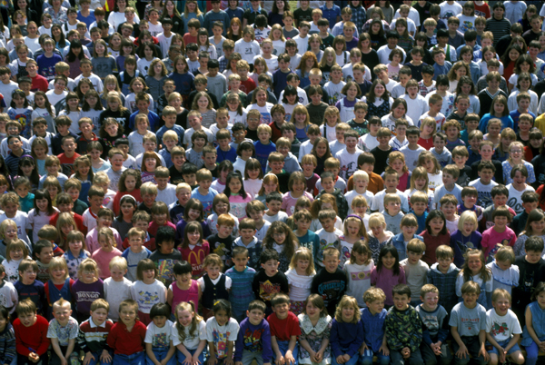
11,500 Adults
6,500 Children
But how do they get the food?

Slide 5
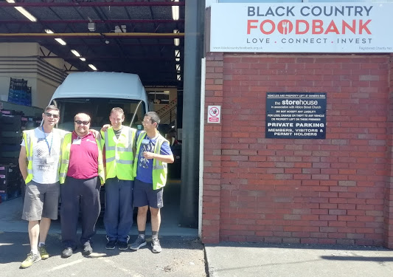
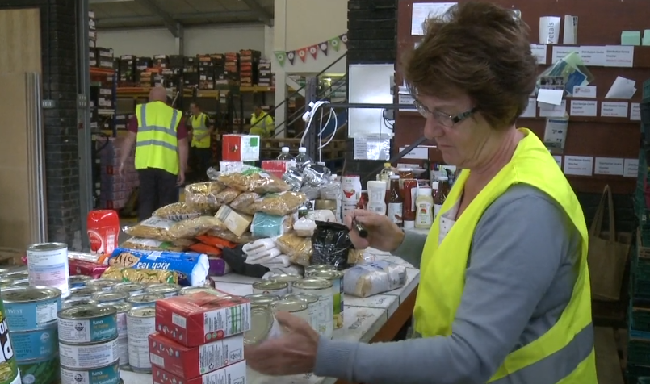
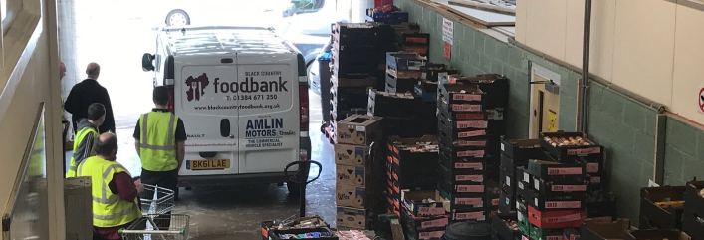
Storehouse
Storehouse

Slide 6

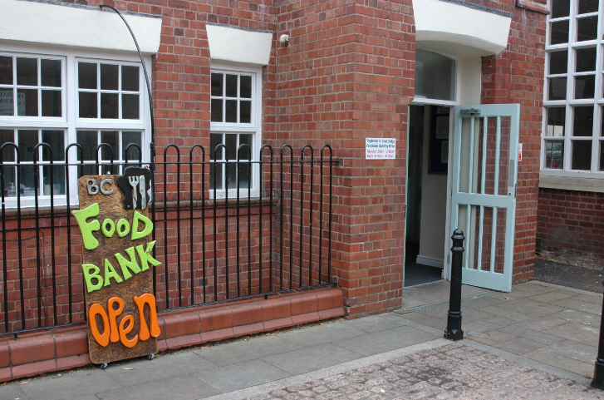
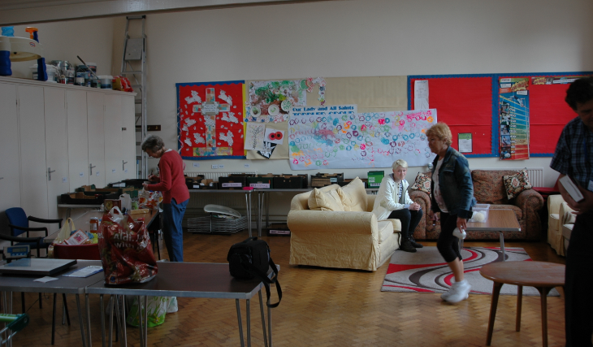

Slide 7
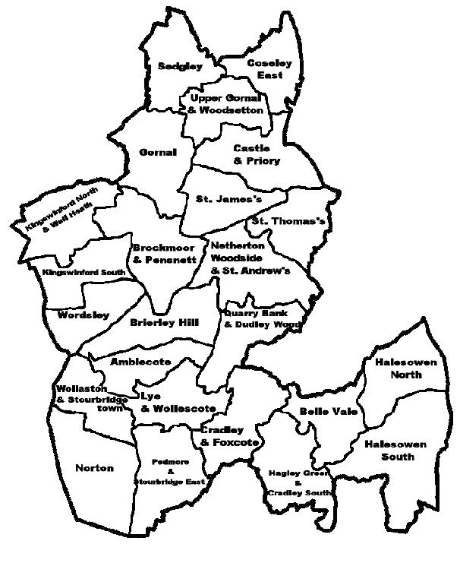
Where we are…
Walsall
Tipton
Oldhill

Slide 8
It was enough to make….
180,000
Dinners!

Slide 9
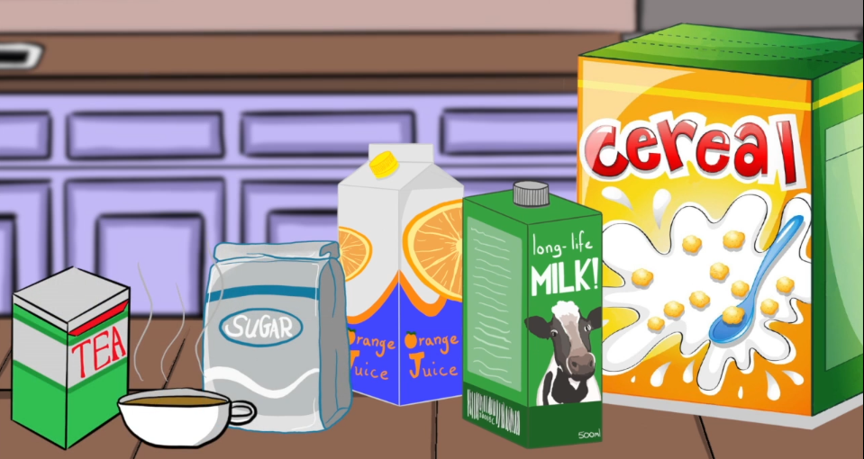

Tins and Packets

Slide 10
Thank You!

